Slide 1

RISK AND RESILIENCE BOOTCAMP
1
Notes:
https://www.ncsc.gov.uk/static-assets/documents/PwnedPasswordsTop100k.txt

Slide 2


Slide 3
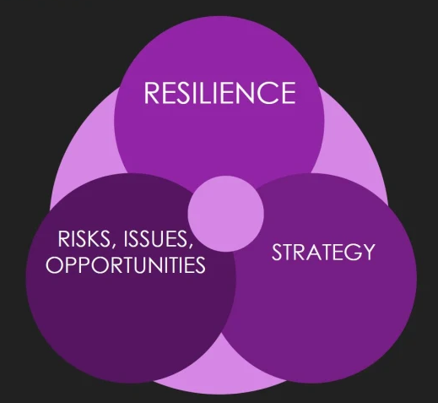
Risk And resilience
In this module we will
Define risk and resilience
Begin with an intuitive and informal approach
Introduce related concepts
Introduce the first case study
Image credit: https://skefto.com/blog/resilience-strategy-and-risk/

Slide 4
Informal Definitions
Risk and resilience are often used in an informal sense
Risk is associated with the probability of an event happening
But with some implication of a negative consequence if that event occurs
“There is a risk of rain today, which means I might have to cancel our picnic”
“The operation has some risk to it; you might lose feeling in your leg”
Risk management requires a standardized and more precise definition
Resilience implies that something is tough
Meaning that it can recover from negative events or attacks
“He is a resilient fighter, he took a lot of punches but managed to come back and win the fight”
“This material is so resilient that, no matter how you bend it, it snaps back to its original shape”
Like risk, a more precise formulation of “resilience” is needed

Slide 5
Rating Risk
Risk events are evaluated along two dimensions
Events have a probability of occurring
“The chance of a hurricane making landfall in Boston MA this year is very unlikely”
“There is a good chance a hurricane will make landfall in Florida this year”
Events have outcomes that tells us the magnitude of the impact of the event
Both dimensions can be quantitative or qualitative
“There is a 45% chance of a hurricane hitting Miami that would cause between $400 million and $800 million in property damage”
“There is a moderate chance of a hurricane hitting Miami that would cause high levels of property damage”
Qualitative measures are often good enough for informal risk evaluation
A primary goal of risk evaluation is to rank the severity of risks in order to prioritize which ones we should address first

Slide 6
Ranking risk
To prioritize risks
We have to “pick our targets”
We can’t do everything, so we have to ignore some risks to focus on others
The ones we ignore should be either very unlikely to occur or have a very minor impact
A typical assessment for risk occurrence is a set of ranked categories
Certain: it definitely will happen
Likely: the chance the event occurring is greater than it not occurring
Possible: even odds of the event occurring
Unlikely: the chance the event occurring is less than it not occurring
Rare: the chance of it happening is very low
Eliminated: the event cannot occur

Slide 7
Ranking risk
An assessment for outcomes is also a set of ranked categories, for example
Catastrophic: death or permanent total disability, significant irreversible environmental impact, total loss of equipment
Critical: accident level injury resulting in hospitalization, permanent partial disability, significant reversible environmental impact, damage to equipment
Marginal: injury causing lost workdays, reversible moderate environmental impact, minor accident damage level
Minor: injury not causing lost workdays, minimal environmental impact, damage less than a minor accident level
If there is no negative outcome when the event occurs
Then there is no risk because the event has no impact on us
Once there are rankings of the likelihood and outcome
We can classify the overall risk of the event
Usually taken as the informal product of the two rankings
Often represented by a risk matrix

Slide 8
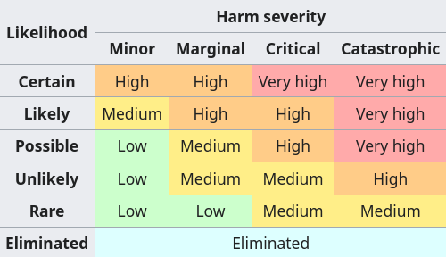
Risk matrix
Each risk can now be prioritized
The very high risks are dealt with first
These events are certain or likely to happen and will have severe negative impacts
These generally need to be done urgently
We may ignore the low risks
We can prioritize management of the mid-range risks based on other criteria
For example, high costs of a high risk mitigation may mean deferring actions because we can’t afford to do it
Or a medium risk may be deferred because the skill sets to mitigate it might not be available
Establishes a way to triage risks

Slide 9
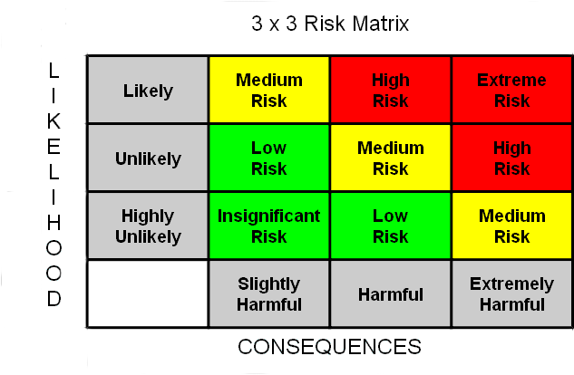
Common risk matrices
A risk matrix is a visual tool
There is no official format
On the right is a common 3x3 form
The example is qualitative
Useful as a first analysis
Often uses historical data and expert opinions to come to a preliminary decision
This is called a qualitative analysis

Slide 10
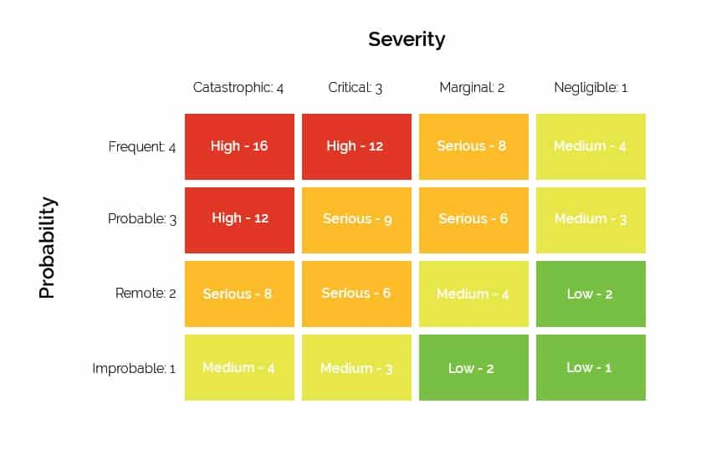
Common risk matrices
Another variant is the 4x4
This matrix assigns a numerical value for both probability and severity
This produces a risk score ranging from 16 (4 x 4) to 1 (1 X 1)
This is still qualitative
The values are not computed from data
They are ordinal, not arithmetic
Often used to support automation and data analysis instead of textual labels

Slide 11
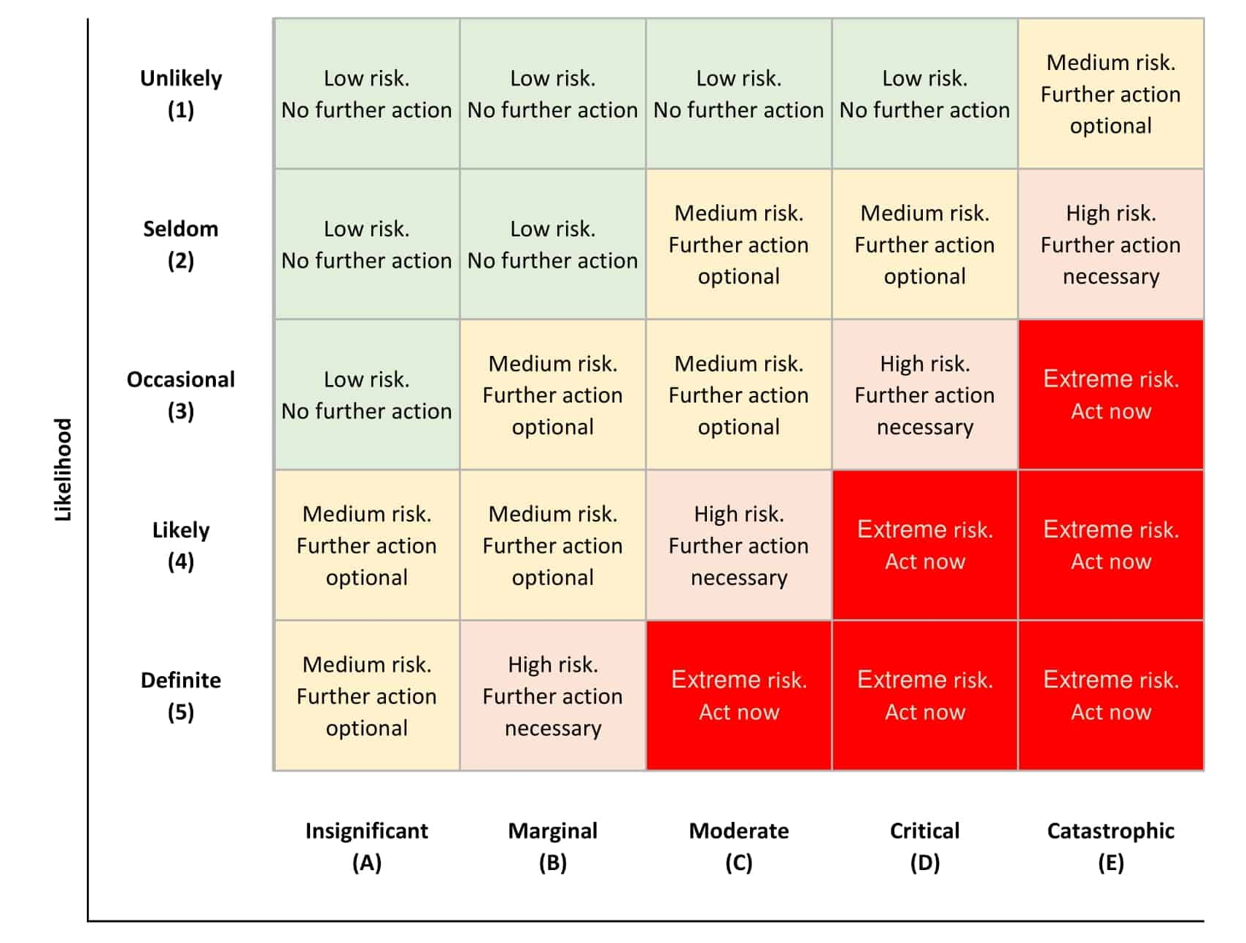
Common risk matrices
Shown is a 5x5 matrix
Incorporates a risk management decision to prioritize responses
These examples show there is no “correct” form of a risk matrix
They all express the idea of computing risk as a combination of likelihood and outcome
The actual risks will depend on how we choose to define and classify them
Those choices are what we need to get right in a risk assessment

Slide 12
Quantitative risk matrices
Quantitative matrices use data to assign the frequency and outcome values
These values are usually derived from existing data
They can be based on some mathematical model; a regression analysis for example
The model might incorporate:
Analyses of historical data to predict the likelihood of an event
This could be expressed as a probability of the event occurring according to a statistical model
A set of impacts on affected populations based on historical occurrences
For example, historical records of the dollar value of damage for similar events
Used for a more comprehensive description of the risk
The next page shows a quantified risk matrix from the liquid natural gas industry
No matter how detailed or precise the risk matrix is
It doesn’t tell us how to manage risk or reduce the risk
We need a standard set of concepts, procedures and strategies for responding to risk

Slide 13
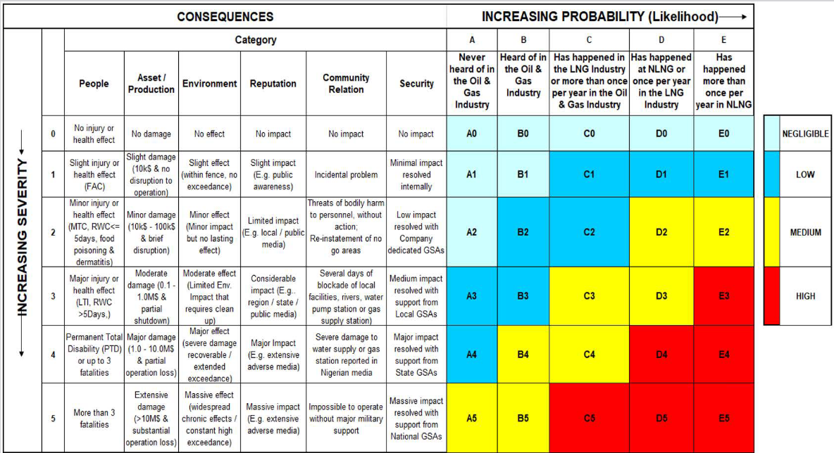
LNG risk matrices

Slide 14
ALTERNATIVE TERMINOLOGY
Our discussion so far
We have used the idea of risk events with a probability of occurrence with a potential outcome
Another way of describing this:
There exist threats to the organization
Threats are events, but the term threat emphasizes the negative nature of the event
A power outage is a threat, so is a hacker attack
Threats are exploited through vulnerabilities
A vulnerability represents a negative outcome
The more vulnerable we are correlates with higher negative impact of the threat
Mitigating the vulnerability reduces the effect of the threat
For example
An earthquake represents a threat to our data center since it can have a negative impact on our data center
Locating the data center near a fault line is a vulnerability because it increases our potential to take damage from the threat

Slide 15
Resilience Concepts
Resilience refers to how a system deals with negative events and returns to normal operations
Resilience is not about avoiding negative events
We accept the fact that negative events will occur and will impact the system
A resilient system absorbs these events with no or only minimal loss
Resilience means the systems recovers from the event with minimal effects
If the system goes down in whole or part, its function can be restored quickly
Related concepts
Continuity: refers to the idea a business, for example, can continue to function even when there is a failure in a system, although it might operate at a reduced capacity for a while
Reliability: refers to the idea that the resilience of the system ensures it is consistently available and operational

Slide 16
Resilience
Basic themes in resilience operations
Anticipate: Identify the points of failure and dependencies where things could go wrong
Withstand: Keep operations running when parts fail
Maintain continuity of operations, even at a degraded level
Recover: Restore full operations quickly
Recovery strategies, restore from backups, switch to redundant systems, and execute failover plans
Adapt: Learn from incidents and improve
Improves the reliability of the system
Like risk management, resilience needs
Standard concepts, procedures and protocols, including assessment tools
Constant improvement in the organization’s resilience processes and procedures
To be integrated across systems and coordinated with other functional areas

Slide 17
ISACA IT Risk framework
Purpose of a framework
Turns risk intuition into repeatable, outcome driven practices
Benefits of a formal framework
Consistency: Everyone scores, prioritizes, and responds to risks in a standardized manner across organization, teams and industries over time
Comparability: Trade‑offs can be evaluated across products, systems, and business units
Defensibility and auditability: Clear decision trails
Regulators and auditors can trace the logic and the actions taken
Bias reduction: Structured steps help avoid cognitive biases such as:
Recency bias: too much emphasis on recent data rather than potentially more relevant historical data
Availability bias: too much importance on vivid or dramatic data rather than a comprehensive and full analysis of the data
HiPPO effects: (Highest Paid Person Opinion) too much emphasis on the most senior person’s opinion

Slide 18
ISACA IT Risk framework
Benefits of a formal framework (cont)
Speed with quality: Templates and best practices allow previous experience to be leveraged to provide faster, more efficient and effective responses in the future
Risk appetite: Actions are taken that correlate with the organization’s acceptable risk policies rather than informal gut feelings or individual one-off decisions
Governance integration: Allows for integration with governance processes, KRIs/KPIs, incident/BC/DR processes (business continuity and disaster recovery)
Communication: Content is packaged appropriately for different audiences
Executives get business‑impact summaries
Engineers get actionable control guidance
Regulators get standardized compliance reports

Slide 19
Formal vs informal definitions
Risk
Informal
“Something bad might happen because…”
“It would be terrible if someone could break into our system with administrator privileges”
Formal Definition
A potential event/condition with likelihood and impact on objectives
Issue
Informal
“Something bad could happen if we don’t fix this”
“The administrator account login has not been disabled for external logins over the Internet”
Formal Definition
A current problem (realized risk) requiring remediation

Slide 20
ISACA IT Risk Definitions
Control
Informal
“Unless we put this security feature into place, bad things will happen”
“We need to ensure administrators can only log in from inside our IT department network”
Formal Definition
A policy/process/technical measure to reduce likelihood/impact or detect/recover
Incident
Informal
”That issue we didn’t address, it just caused a bad thing to happen”
“Someone hacked in as administrator and deleted the entire code base for our next release”
Formal Definition
A disruptive event affecting confidentiality, integrity, availability, or operations.

Slide 21
ISACA IT Risk Definitions
Remediation
Informal
“We need to deal with this security issue”
“We need to ensure administrators can only log in from inside our IT department network”
Formal Definition
Actions to resolve an issue or strengthen controls to reduce risk
Recovery
Informal
“We dodged a bullet this time”
“We were able to restore the deleted code base from the last backup with minimal loss so we can continue development”
Formal Definition
Activities to restore services/data to an acceptable state and service level agreements

Slide 22
ISACA IT Risk Definitions
Inherent risk
Informal:
“All the risk we face before we do anything”
“Literally anyone can log into our system from anywhere as administrator and use a brute force attack to get full system access”
Formal Definition
The level of risk before considering existing controls
Residual risk
Informal
“We fixed most of the problem, but there are still some issues”
“No one can get administrator access from outside, but we still have to worry about social engineering attacks on our existing staff to gain internal access”
Formal Definition
The level of risk after controls are applied

Slide 23
ISACA IT Risk Definitions
Risk appetite
Informal:
“We are willing to take these risks otherwise we may not be able to get something important done”
“Because we are committed to developing AI tools, we are willing to accept the risks inherent in new technology development”
Formal Definition
The amount of risk an organization is willing to accept in pursuit of its objectives
Risk tolerance
Informal:
“How much risk we are willing to accept before we start to panic”
“No more than 2% of transactions per year may fail due to IT issues”
Formal Definition
The acceptable level of variation in outcomes related to specific risks, often expressed in measurable thresholds

Slide 24
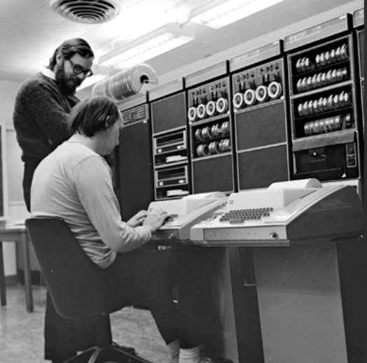
Risk Tolerance example
UNIX operating system and C programming language
Both ave a reputation for being “risky”
Programmers can write C code on a UNIX system that would crash or brick the system
This requires a high risk tolerance
Doug Gwyn explains why
“Unix was not designed to stop you from doing stupid things, because that would also stop you from doing clever things”
Risk management is the programmer’s responsibility, not the operating system’s responsibility

Slide 25
Risk categories
Different industries have different risk categories
But there are commonalities across industries
The focus in this course is on the financial services industry
Enterprise Risk Management (ERM) categories
Strategic: risks that affect achievement of high-level goals aligned with mission/strategy
For example: deploying AI tools that negatively impact the core business processes
For example: transforming the IT infrastructure produces deadlocks in developments
Operations: risks from day-to-day processes, people, systems, or external events that impair effective and efficient operations
For example: outages, control breakdowns, failure to respond to security events
For example: failed updates to production systems, configuration errors

Slide 26
Risk categories
Enterprise Risk Management (cont)
Reporting: risks that reports are unreliable, incomplete, or untimely
For example: delayed suspicious activity reporting (SAR)
For example: data quality errors in financial consolidation reporting
Compliance: risks of compliance failures with regulators
For example: risks of violating laws, regulations, or internal policies about privacy, or consumer-compliance technology issues

Slide 27
Risk categories
ISACA has four main categories
Benefit enablement risk:
The risk that technology-enabled initiatives don’t deliver the expected business value
For example: customer loss because of difficult to use automated systems
For example: operations monitoring tools do not improve efficiency in the production operations environment
Program and project delivery risk
The risk that programs or projects fail on scope, time, cost, or quality
Causes business disruption or lost opportunities
For example: the development process for new applications is disorganized and inefficient
For example: rolling out a new application is overdue and is unusable for some users

Slide 28
Risk categories
Operations and service-delivery risk
The risk that day-to-day IT services under perform or fail
For example: the new customer relations system regularly hangs, annoying customers
For example: data required for executives decisions is late or inaccurate
Cyber and information security risk
The risk from threats to information and technology
For example: confidentiality, integrity, availability
For example: cyber attacks and unintended exposure of confidential data

Slide 29
Resilience
Differences between risk and reliability/resilience
Risk management focuses on preventing things from going wrong
Reliability focuses on maintaining normal operations when things go wrong
For example, systems that reject bad data that has the potential to crash operations are reliable because they continue to function even when given corrupted input
Resilience is about absorbing bad events and getting back to normal fast
If bad data does crash the system, it reboots and is online with minimal downtime
Resilience is about expecting failure, limiting the fallout, and returning to service predictably so customers and the business keep operating
Reliability tries to avoid failure
Resilience assumes failure will happen and focuses on recovery from the failure

Slide 30
Resilience
Security vs. Resilience
Security reduces the likelihood of attacks by an adversary will succeed
Resilience reduces the impact and duration of the effects of an attack on the system
Redundancy vs. Resilience
Redundancy is a tool (extra capacity, backups)
Resilience is the strategy that decides where and how to use redundancy tools
Resilience (recall)
Anticipate: Spot what could go wrong (single points of failure, dependencies)
Withstand: Keep core services running when parts fail (graceful degradation)
Recover: Restore full service quickly (clear roles, practised runbooks, tested backups)
Adapt: Learn from incidents and improve so the same issue hurts less next time

Slide 31
Resilience Definitions
Organizational resilience
“Ability of an organization to absorb and adapt in a changing environment to deliver objectives and to survive and prosper”
RTO (recovery time objective)
How fast the organization must restore an activity/service to an acceptable level after a disruption
The amount of down time needed to be restore the system enough to continue operations normally
RPO (recovery point objective)
How much data the organization can afford to lose
Expressed as a point in time that the process must be able to roll back to
For example: “no more than 5 minutes of orders lost”

Slide 32
Resilience Definitions
MTPD (maximum tolerable period of disruption)
Beyond this duration, the impact on the business becomes unacceptable
Outer limit for a disruption before the the business suffers loss
RTO must always be set inside this boundary
Also called MAO Maximum Acceptable Outage
MBCO (minimum business continuity objective)
The minimum acceptable performance level during disruption
For example: “process 20% of payments during system recovery”
The RTO is the time to reach at least the MBCO
BIA (business impact analysis)
Analysis step that quantifies impact over time and helps calculate realistic RTO/RPO per activity/application

Slide 33
Bank example
Payments process routing:
MTPD: 2 hours
Beyond that: regulatory, reputational impact is unacceptable
RTO: 15 minutes to MBCO
Time required to route 30% of traffic through secondary processor (MBCO)
RPO: 1 minute
Can’t lose more than 1 minute of auth logs/transactions
Resilience Planning:
Synchronous replication for auth logs, hot-hot routing, automated failover playbook

Slide 34
Bank example
Trade confirmations portal:
MTPD: 24 hours
RTO: 4 hours
Read-only mode acceptable initially
RPO: 15 minutes
Replayable from upstream book of record
Resilience Planning:
Frequent backups + near-real-time replicas; runbook for read-only mode

Slide 35
Business Impact Analysis
Structured way to assess how bad things get over time when a business activity or IT service is disrupted
Quantifies the impacts on financial, customer, regulatory, operational dimensions
Used to set targets for resilience planning, specifically
RTO: How fast the system must be back to a minimum level
RPO: How much data the business can afford to lose
Identifies
Which services matter most
How quickly the pain escalates
What recovery promises have to be kept
Also useful for discovering risks

Slide 36
Business Impact Analysis
BIA key outputs
Criticality tier for each related or dependant service or application
An evaluation of how important each service is to maintaining business continuity
Tier 1 “mission critical,” Tier 2, etc.
Impact curve over time
Scale of tolerable service degradation to the severe service degradation that is unacceptable versus time
A measure of how the impact to the business gets worse over time
MTPD/MAO for each activity
Defines the outer limit for what is acceptable
RTO and RPO targets
Defines the targets are that are to be designed to and tested against

Slide 37
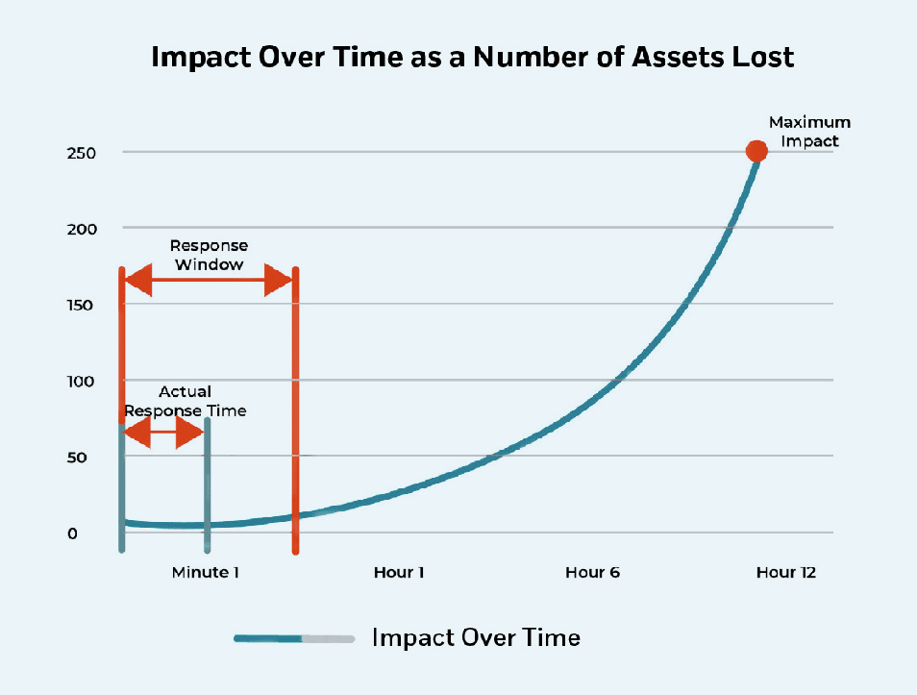
Business Impact Analysis
BIA key outputs
Criticality tier for each related or dependant service or application
An evaluation of how important each service is to maintaining business continuity
Tier 1 “mission critical,” Tier 2, etc.
Impact curve
Scale tracking service degradation over time from tolerable service degradation to unacceptable
Measure of how the impact to the business gets worse over time

Slide 38
Business Impact Analysis
Minimum Business Continuity Objective (MBCO):
The minimum acceptable service level during disruption
Although service might be degraded, defines minimum level of service to avoid business failure
Dependency map
Identifies the people, locations, technology, data and third parties that are involved or impacted
Regulatory/contractual constraints
Identifies the legal and compliance issues that have to be taken into account
Important because what the business can tolerate as MBCO might not be acceptable to regulators
Prioritized recovery order and data protection needs
What needs to be done first
How to protect the data assets
Assumptions and residual risks
Identifies what could still go wrong even after a recovery
For example, determining if an outage a planned diversion by someone hacking the system

Slide 39
How to run a BIA
Phase 1: Prepare (1–2 weeks)
Define scope: Which business activities are to be analyzed
Identify the underlying IT services that are involved
Applications, databases, payment rails, call center, branches systems
Pick impact criteria describing the impact of failure along various dimensions
Financial (per hour/day)
Customer (volume affected, VIP segments)
Regulatory (reporting deadlines, penalties)
Operational (manual workarounds)
Reputation (media/social triggers)
Use a quantified scale with concrete thresholds
For example: “Regulatory breach likely” = level 4

Slide 40
How to run a BIA
Phase 1: Prepare (cont)
Collect reference data
Past incidents, SLAs, volumes, cutoffs, market windows
For example : payment settlement times, control test results, known issues
Example impact criteria for a bank
Financial: revenue loss, fees/penalties, trading P&L, cost of manual work
Customer: number of customers unable to transact, VIP/segment impact, queue/abandon rates
Regulatory & Legal: reportable incidents, filing deadlines missed, consent order exposure, fines
Operational: throughput drop, backlog growth, staff hours for workaround, dependency breakage
Reputation: media/social escalation, complaints, net promoter score drop, executive attention
(Optional) Safety/People: rarely used in IT-only outages, but included if relevant (example, fire sensor software)

Slide 41
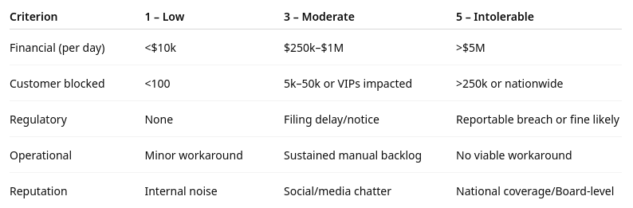
How to run a BIA
Phase 1: Prepare (cont)
Example: ranked impact criteria for a bank

Slide 42
How to run a BIA
Phase 2: Elicit and validate (2–4 weeks)
Interviews/workshops
With business owners and tech leads (Dev/SRE/DBA/Network)
Use the same questionnaire to ensure comparability
What does the activity produce? Who depends on it?
What happens at 15m / 1h / 4h / 24h / 3d of downtime?
What data would be lost at different points? How hard is reconciliation or restoration?
What’s the minimum acceptable level for business continuity (MBCO)?
Any hard deadlines: market close, clearing windows, regulatory submissions
Map dependencies
Applications, data stores, identity, networks, endpoints, facilities, vendors, SLAs
Quantify impact over time
Convert narratives into scores and impact curves
Identify the time when impact becomes unacceptable, that becomes the MTPD/MAO

Slide 43
How to run a BIA
Phase 3: Set targets and align (1–2 weeks)
Derive targets
RTO = time to resume to at least the MBCO, and always < MTPD
RPO = max tolerable data loss window based on data volatility and reconciliation cost
Prioritize recovery order
If multiple services are down, identify the order in which they should be restarted
Validate feasibility with IT:
Can the current architecture meet RTO/RPO?
If not, document the gaps, options, and costs to make it compliant

Slide 44
How to run a BIA
Phase 4: Publish and embed (1 week)
Deliver the BIA register/report
Criticality tiers, impact curves, targets, dependencies, assumptions
Flow targets into plans and tests
Update DR runbooks, exercise calendar, monitoring dashboards (RTO/RPO/MTPD)
Set review cadence:
Re-run or refresh annually or after major changes
For example: mergers, platform shifts, new regulations

Slide 45
How to determine RTO
Scope the activity
Name the business service
For example: card authorizations
And the IT stack that supports it
For example: apps, DBs, networks, vendors
Execute a BIA
Quantify impact as a function of outage time
For example: financial, customer, regulatory, operational
Identify the MTPD/MAO: the point at which impact becomes unacceptable
Set a measurable target
Pick the RTO < MTPD that reflects the minimum acceptable level of service (MBCO).
Example: “15 minutes to read-only balances, 60 minutes to full function”

Slide 46
How to determine RTO
Check external constraints
Regulatory rules, customer SLAs, market hours, and cutoffs like payment settlement windows that may force a tighter RTO
Design to the number
Choose strategies that can actually meet the RTO
For example, active-active, hot standby, autoscaling, automated failover, pre-provisioned capacity
Cost–risk tradeoff
Compare business benefit of a shorter RTO vs. added run costs and complexity
Adjust if the economics don’t justify “minutes”
Document and test
Put RTO in runbooks and DR plans
Validate with timed exercises; record actual recovery time and fix gaps

Slide 47
How to determine RpO
Understand the data that would be affected
For example: orders, trades, auth logs
How often they are updated, their rate of change
How they are reconciled if the data is lost
Establish the tolerance
With business owners, set the largest acceptable loss window
For example: “≤ 5 minutes of orders lost”
Map to data protection options
RPO ≈ 0: synchronous replication, dual-write, commit-quorum
RPO in minutes: asynchronous replication + frequent log shipping/snapshots
RPO in hours: periodic backups are sufficient

Slide 48
How to determine RpO
Check downstream dependencies
If systems feed each other, the strictest RPO in the chain often dictates the RPO for all the other related systems
Prove recoverability
Run point-in-time restores and message replays to show you can recover on before the specified RPO
Keep logs as evidence

Slide 49
REAL WORLD ISSUES
Feasibility loop
If architecture can’t meet the chosen RTO/RPO then either
Invest (hotter standby, faster replication) or
Revise targets with signed risk acceptance
Tiers
Not every component needs the same target
Design graceful degradation
For example, read-only mode meets RTO for one subsystem while other subsystems work on meeting their RTO

Slide 50
Risk contribution
Implicit in the discussion of resilience
The assumption is that we understand the risks involved in outages of any type
Essential in doing a BIA
In developing a BIA, it might be discovered that some failures cannot be recovered from
For example:
A critical system is a legacy system which no one really understands anymore
The in house expertise to perform the recovery operations does not exist
The IT dependencies are so complex that a single failure might result in a cascading total failure of the entire IT infrastructure

Slide 51
Risk contribution
This creates a risk profile that might not have been obvious before
Risk management then has to assess the various types of risks discovered
Generally uses the following categories for discovered risk
Operational risk: Risk of loss from inadequate or failed processes, people, and systems or from external events; includes legal risk, excludes strategic and reputational risk
Information security & privacy risk: Risk to organizational operations/assets and individuals from the operation and use of information systems (security and privacy)
Strategic risk: Risk to achieving strategy and business objectives (e.g., tech choices that hinder strategy execution)
Compliance risk: Risk of violations of existing laws/regulations or internal policy requirements

Slide 52

Q&A and open discussion

